Slide 1


Decision Support and Intelligent System
Presented By :
Gagan Pradhan
Rekha Angdembe
Sanish Regmi

Slide 2


Contents
1
Dss,operations search models
2
Group decision support system
3
Enterprise and executive decision support system
4
Knowledge management , Knowledge based expert system
5
AI , Neural Networks, Virtual reality, Intelligent agents
6
Data mining , data ware housing , OLAP ,OLTP
7
Anomaly and fraud detection

Slide 3
Decision
The act of choosing a course of action from several alternatives to achieve a specific objective or solve a problem.
In the context of information systems, it is the outcome of analyzing and interpreting data to determine the best course of action or solve a problem using technology and computational tools.

Slide 4
Decision Making
Four different stages in decision-making:
Intelligence
Design
Choice
Implement

Slide 5
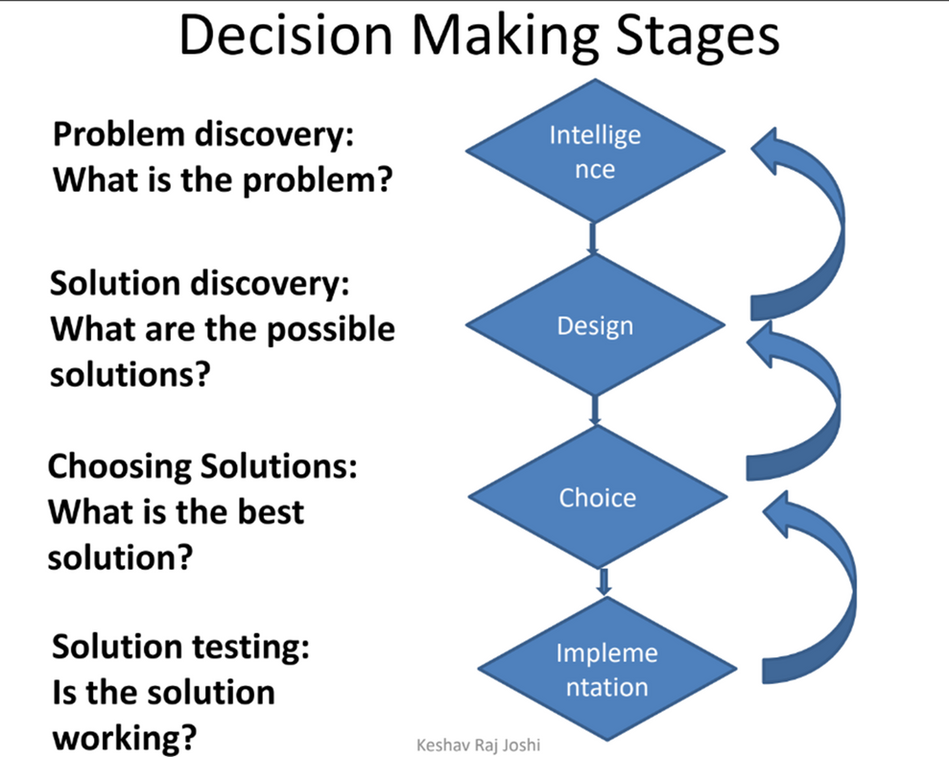
Decision Making

Slide 6
Decision Support System (DSS)
A computer-based information system that helps individuals or organizations make informed decisions.
a collection of integrated software applications and hardware
DSS serve the management, operations, and planning levels of an organization
DSS are used to collect data, analyze and shape the data that is collected, and make sound decisions
It uses data, analytical tools, and models to solve problems, evaluate alternatives, and predict outcomes

Slide 7
Characteristics of DSS
Facilitation: It helps and supports specific decision-making activities and processes by providing useful tools and insights.
Interactive Use: DSS is designed to be interactive, allowing decision-makers or staff to control how the system is used and what operations are performed.
For Regular and Occasional Use: DSS can be used repeatedly, either as part of routine decision-making or for solving unique, one-time problems.

Slide 8
Characteristics of DSS
Task-Focused: Supports specific tasks in decision-making, such as analyzing data, identifying options, comparing alternatives, and implementing decisions.
Improves Decisions: Aims to make decisions more accurate, timely, and effective, improving overall quality and outcomes.
Supports Individuals and Teams: Provides a shared platform where everyone can access the same data while allowing users to customize reports or analyses for their specific needs.
Access to Diverse Data: Enables users to access data from multiple sources at the same time, giving organizations the flexibility to use the best data warehouse for their needs.

Slide 9
Objective of DSS
Supports the manager in the decision-making process but does not replace it.
Increase the effectiveness of the managers decision- making process.
Support Complex Problem-Solving
Increase Decision Quality

Slide 10
DSS Components
Inputs: Factors, numbers, and characteristics to analyze.
User Knowledge and Expertise : Inputs requiring manual analysis by the user.
Outputs : Transformed data from which DSS "decisions" are generated.
Decisions : Results generated by the DSS based on user criteria.

Slide 11
DSS Advantages
Time savings
Enhance effectiveness
Competitive advantage
Cost reduction
Increase decision-maker satisfaction
Promote learning
Improves personal efficiency

Slide 12
DSS Applications
Medical diagnosis
Business and Management
Agricultural production
Transportation
Military
Aviation
Customer profile monitoring in banks

Slide 13
TYPES OF DECISIONS
Structured/programmed Decision
Schedule decisions
Organization develops specific process handling
Rules of decision making system are predefined

Slide 14
TYPES OF DECISIONS
Unstructured / Non-programmed Decisions
Repetitive decisions
Handled by general problem solving process
Decision taken by Decision Support Systems
Rules of decision making system are not fixed or predetermined

Slide 15
TYPES OF DECISIONS
Semistructured Decisions:
Some decision procedures can be specified in advance, but not enough to lead to a definite recommended decision

Slide 16
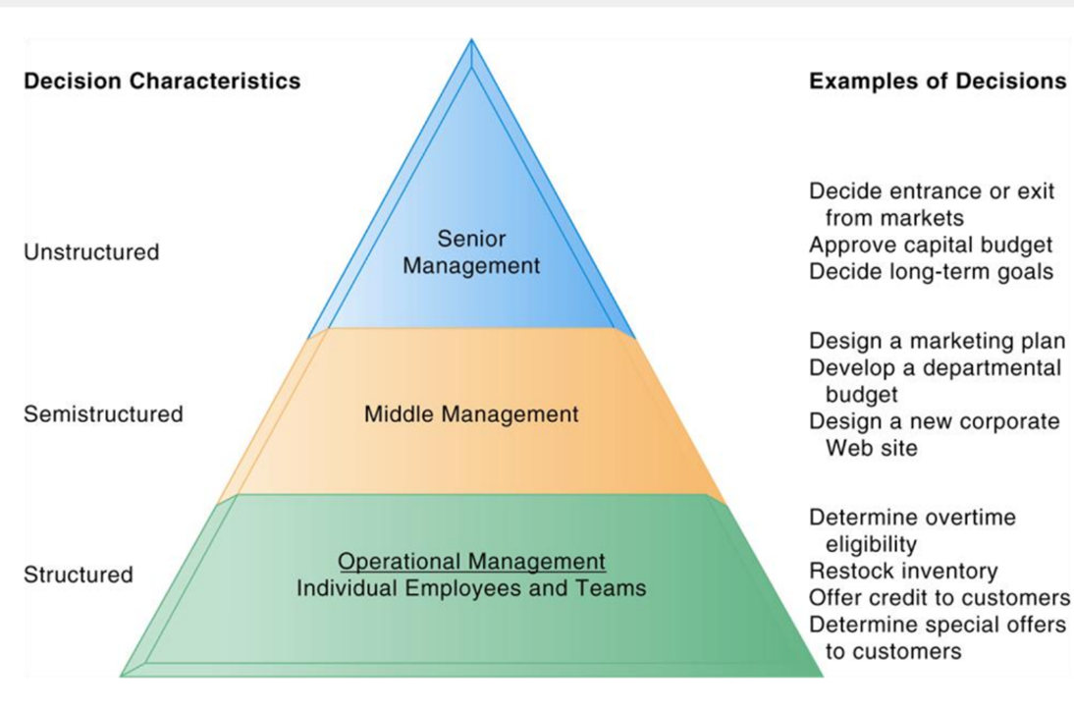

Slide 17
Decision Support System Models
Behavioral Models
Management Science Models
Operation Research Models

Slide 18
Decision Support System Models
Behavioral Models
The decision maker can make the decisions for such behavioral relationships.
For eg: The trend (development) analysis, forecasting and statistical analysis models.
The trend analysis indicates how different variables behave in trend setting in the past and hence in future.
In Market Research method, they can forecast or judge the behavior of the customers buying decisions. (i.e. The questionnaire are designed and computerized to evaluate customer’s buying behavioral).

Slide 19
Decision Support System Models
Management Science Models
These models are developed on the principles of the business management, accounting and economics. For eg: the budgetary systems, cost accounting system, inventory management system.
In the budgetary system, budgets are used for planning and control.
In all the organization, budgets are prepared with the use of graphical representation in the form of line charts or bar charts.
For eg : Sales Budget, Production Budget

Slide 20
Decision Support System Models
Operation Research Models
These are the mathematical models in providing guidelines to managers for making effective decisions within the state of the current information
Some applications
Telecommunications/Road/Rail Network Design
Organization Supply Chain Strategy
Revenue, Pricing and Promotions
Demand Forecasting
Project Planning

Slide 21
Decision Support System Models
Operation Research Models
For eg : Linear Programming is mathematical modeling technique useful for guiding quantitative decisions in business planning, industrial engineering, and—to a lesser extent in the social and physical sciences.

Slide 22
Group Decision Support System (GDSS)
A Group Decision Support System (GDSS) is a technology-driven system designed to assist groups in analyzing problems and making more efficient, informed, and collaborative decisions. It typically combines software, hardware, communication networks, and decision-making tools that facilitate the sharing of data, ideas, and feedback among team members. GDSS aims to streamline the decision-making process, reduce conflicts, and improve overall group communication and outcomes.

Slide 23
Group Decision Support System (GDSS)
Example
Corporate Board Meetings:
software like ThinkTank or MeetingSphere
Government Planning Committees: Consensus Decision Support System (CDSS) from Touchstone Energy.
Crisis Management:GDSS used in crisis management is Cognos Analytics

Slide 24
why GDSS?
A GDSS offers several advantages, including improved decision-making quality, time and cost savings, increased participant satisfaction, effective communication, and a more inclusive environment for all group members. Additionally, it fosters better group dynamics, reduces conflict, and mitigates the negative effects of groupthink.

Slide 25
Advantages of GDSS
Increase collaboration
Diverse input
Structured decision process
efficiency & time saving
anonymity for honest input
Improved decision quality
remote participation
enhanced communication

Slide 26
Dis Advantages of GDSS
Technical Challenges
Resistance to technology
Overemphasises on anonymity
complexity
dependency on technology
security concern
high initial cost

Slide 27
Enterprise Decision Support System (EDSS)
An integrated information system designed to support decision-making processes at the enterprise or organizational level
It typically integrates data from various departments, sources, and levels within the organization, allowing managers and decision-makers to make more informed, strategic decisions.
Used mainly by specialists such as planners, analysts and researchers
Used for an organizational task that involves a sequence of operations and decision-makers, e.g constructing a marketing plan

Slide 28
Enterprise Decision Support System (EDSS)
Enterprise Systems: Concepts and Definitions
Executive information systems (EIS)
Executive support systems (ESS)
Enterprise information systems (EIS)

Slide 29
Enterprise Decision Support System (EDSS)
Executive information systems (EIS)
An Executive Information System (EIS) is a specialized type of decision-support system designed to provide senior executives and top-level management with quick, easy access to critical information needed for decision-making. EIS focuses on summarizing and presenting high-level information, often drawn from various sources across the organization.

Slide 30
Enterprise Decision Support System (EDSS)
Executive support systems (ESS)
Comprehensive support system that goes beyond EIS to include
Communications
Office automation
Analysis support
Intelligence

Slide 31
Enterprise Decision Support System (EDSS)
Enterprise information systems (EIS)
Corporate-wide system
Provides complete information
From a corporate view
Part of enterprise resource planning (ERP) systems
For business intelligence
Leading up to enterprise information portals and knowledge management systems

Slide 32
Characteristics of EIS
Drill down
Critical success Factors (CSF)
Status access
Analysis
Exception reporting
Navigation of information
Communication

Slide 33
DATA, INFORMATION AND KNOWLEDGE
Data- refers to isolated facts such as individual measurement.No meaning on their own
Information -fact about situation, person, events
Knowledge refers to the understanding, information, skills, and facts that individuals or systems acquire through experience, learning, or education.
Knowledge-processed information

Slide 34
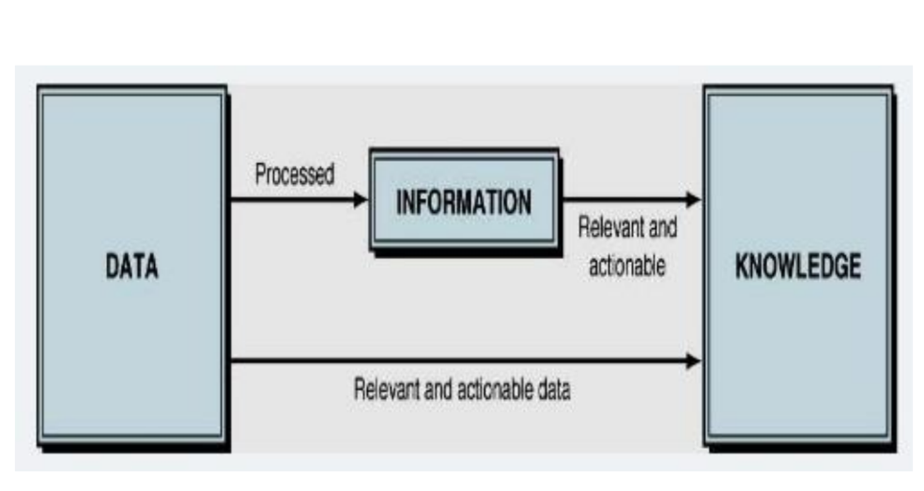

Slide 35

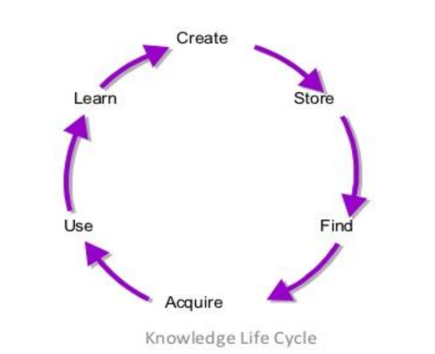
KNOWLEDGE MANAGEMENT SYSTEM
Knowledge management (KM) is the process of identifying, organizing, storing and disseminating information within an organization.
A Knowledge Management System (KMS) is an IT system, through which an organization implements Knowledge Management.The system organizes, stores, and retrieves the collective knowledge of an organization.

Slide 36
KNOWLEDGE MANAGEMENT SYSTEM
Create: Knowledge must be created either within or outside the organization.
Store : Knowledge can be stored somewhere, for others to find and use.
Find: Those who need the specific knowledge must then find out where it is, when they need it, by searching in the right places and asking the right people.
Acquire: Once the knowledge source is found, the user will then go through the act of actually acquiring it
Use : Once acquired, the knowledge can be put to use towards some productive purpose.
Learn: Having been used, perhaps repeatedly, the user will learn what worked well and not so well as a result of applying the knowledge gained.

Slide 37
Knowledge Based Expert System
Knowledge-Based Expert System (KBES) is an Al system designed to emulate the decision-making abilities of a human expert in a specific domain.
It operates by utilizing a knowledge base a repository of facts, rules, and heuristics about a particular field-combined with an inference engine that applies logical rules to this knowledge to draw conclusions
The system's effectiveness depends on the quality and comprehensiveness of its knowledge base and the precision of its inference mechanisms

Slide 38
Feature of Knowledge Base
Knowledge base
The core component of a KBES, the knowledge base, contains domain-specific information, facts, rules, and heuristics. This repository is curated from expert knowledge and provides the system with the data needed to make informed decisions or recommendations. The quality and comprehensiveness of the knowledge base are crucial for the system's accuracy and reliability.

Slide 39
Components of Knowledge Base expert system
Inference Engine
The inference engine applies logical rules to the information in the knowledge base to draw conclusions or make décisions. It uses techniques such as forward chaining (data-driven) or backward chaining (goal-driven) to process the data and solve problems, simulating the reasoning process of a human expert.
An inference engine tries to derive answers from a knowledge base.
It is the brain of the expert systems that provides a methodology for reasoning about the information in the knowledge base, and for formulating conclusions.

Slide 40
Components of Knowledge Base Expert system
User Interface:
KBES typically includes a user interface that allows users to interact with the system. This interface facilitates inputting queries or problems and receiving advice or solutions. It must be intuitive and user-friendly to ensure that users can effectively leverage the system's expertise.
Explanation Facility:
Many KBESs feature an explanation facility that provides users with detailed reasoning behind the system's conclusions or recommendations. This transparency helps users understand how the system arrived at its decisions, enhancing trust and enabling users to verify the system's accuracy.

Slide 41
Expert system
Expert Systems are interactive, trustworthy computer-based decision-making tools that utilize data and heuristics to address challenging decision-making issues. It is regarded as representing the pinnacle of human knowledge and wisdom. An expert system's job is to resolve the trickiest problems in a specific field.
Expert system is an information system application that captures the knowledge and expertise of a problem solver or decision maker, and then simulates the ‘thinking’ of that expert for those who have less expertise.
Expert systems are implemented with artificial intelligence technology, often called expert system shells.

Slide 42
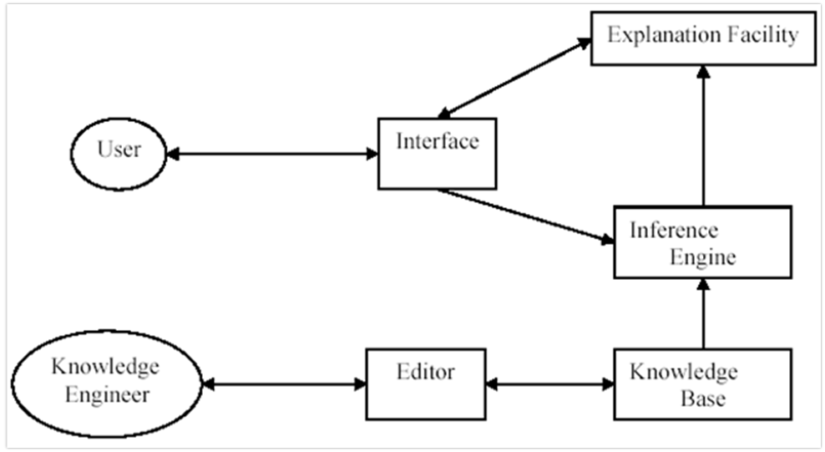
Expert system Architecture

Slide 43
Characteristic of Expert system
A human expert can change, but an expert system can last forever.
It facilitates the distribution of human expertise.
The expert system might incorporate knowledge from multiple human experts, which would increase the effectiveness of the answers.
It lowers the expense of seeking advice from a specialist in various fields, including medical diagnosis.
Instead of using standard procedural code, expert systems can handle complex issues by inferring new facts from known facts of knowledge, which are typically represented as if-then rules.

Slide 44
Benifits of Expert system
Accuracy: Expert systems are immune to emotional or human inaccuracy. They base their choices on facts and rules.
Permanent: When human specialists leave their positions, the technical information could follow. Knowledge-based systems offer an everlasting reservoir of information and knowledge.
Logical deduction: Expert systems use a variety of principles, such as if-then rules, to derive conclusions from data already known.
Cost-control : When compared to the cost of hiring human specialists, expert systems are comparatively cheap. They can assist in making judgments more quickly and inexpensively.
Several experts: The knowledge base of an expert system is augmented by multiple experts. This gives more information to draw upon and stops one expert from influencing the decision-making process.

Slide 45

PREDICTIVE MODELING TECHNIQUES
Classification Models
Classification models predict categorical outcomes, such as customer churn or product defect probability.
Regression Models
Regression models predict continuous outcomes, such as sales revenue or customer lifetime value.
Clustering Models
Clustering models group similar data points together, identifying patterns and insights.

Slide 46

INTELLIGENT SYSTEM
An intelligent system in AI is a technology equipped with the capability to gather data, process it, and make decisions or perform actions based on that data. At its core, an intelligent system mimics the cognitive functions of human beings, such as learning from experience, understanding complex concepts, solving problems, and making decisions.
core components of IS
Machine learning
Natural language processing
Robotics
Expert system

Slide 47

NEURAL NETWORK
A neural network is a machine learning program, or model, that makes decisions in a manner similar to the human brain, by using processes that mimic the way biological neurons work together to identify phenomena, weigh options and arrive at conclusions.
Every neural network consists of layers of nodes, or artificial neurons—an input layer, one or more hidden layers, and an output layer. Each node connects to others, and has its own associated weight and threshold. If the output of any individual node is above the specified threshold value, that node is activated, sending data to the next layer of the network. Otherwise, no data is passed along to the next layer of the network.

Slide 48

NEURAL NETWORK
Neural networks rely on training data to learn and improve their accuracy over time. Once they are fine-tuned for accuracy, they are powerful tools in computer science and artificial intelligence, allowing us to classify and cluster data at a high velocity. Tasks in speech recognition or image recognition can take minutes versus hours when compared to the manual identification by human experts. One of the best-known examples of a neural network is Google’s search algorithm.
Neural networks are sometimes called artificial neural networks (ANNs) or simulated neural networks (SNNs). They are a subset of machine learning, and at the heart of deep learning models.

Slide 49
VIRTUAL REALITY
Virtual reality, or VR, is a technology where the processing power of computers is used to create simulated 3D environments that feel realistic. With virtual reality technology, you are part of a scene rather than merely watching it on a screen.
Virtual reality intends to simulate an environment so that all your five senses are engaged and the atmosphere created feels real. You can interact with the objects as if they were real and physically present and have an immersive, rich experience.
VR technology is still in its early stages, but the improvements that we have made are quite astounding. Three main categories of VR technology are being used in many sectors today, including education and training.

Slide 50
WHY VIRTUAL REALITY IS NEEDED ?
Operations in dangerous environments
There are still many examples of people working in dangerous or hardship environments that could benefit from the use of VR-mediated teleportation.
Workers in radioactive, space, or toxic environments could be relocated to the safety of a VR environment where they could handle any hazardous materials without any real danger using tele operation or tele presence.
Scientific Visualization
±Scientific Visualization provides the researcher with immediate graphical feedback during the course of the computations and gives him/her the ability to 'steer' the solution process.
Application at NASA Ames Research Center is the Virtual Planetary Exploration. It helps planetary geologists to remotely analyze the surface of a planet. They use VR techniques to roam planetary terrains
Scientific Visualization
Scientific Visualization provides the researcher with immediate graphical feedback during the course of the computations and gives him/her the ability to 'steer' the solution process.
Application at NASA Ames Research Center is the Virtual Planetary Exploration. It helps planetary geologists to remotely analyze the surface of a planet. They use VR techniques to roam planetary terrains

Slide 51

DATA MINING
•Data mining refers to extracting knowledge from large amounts of data.
•The data sources can include databases, data warehouse, web etc.
•Data mining refers to the analysis of data.
•It is the computer-supported process of analyzing huge sets of data that have either been compiled by computer systems or have been downloaded into the computer.
• In the data mining process, the computer analyzes the data and extract useful information from it.
•It looks for hidden patterns within the data set and try to predict future behavior. Data mining is primarily used to discover and indicate relationships among the data sets.

Slide 52

DATA MINING
•Data mining aims to enable business organizations to view business behaviors, trends relationships that allow the business to make data-driven decisions.
• It is also known as knowledge Discover in Database (KDD). Data mining tools utilize AI, statistics, databases, and machine learning systems to discover the relationship between the data.
Data mining tools can support business-related questions that traditionally time-consuming to resolve any issue.

Slide 53
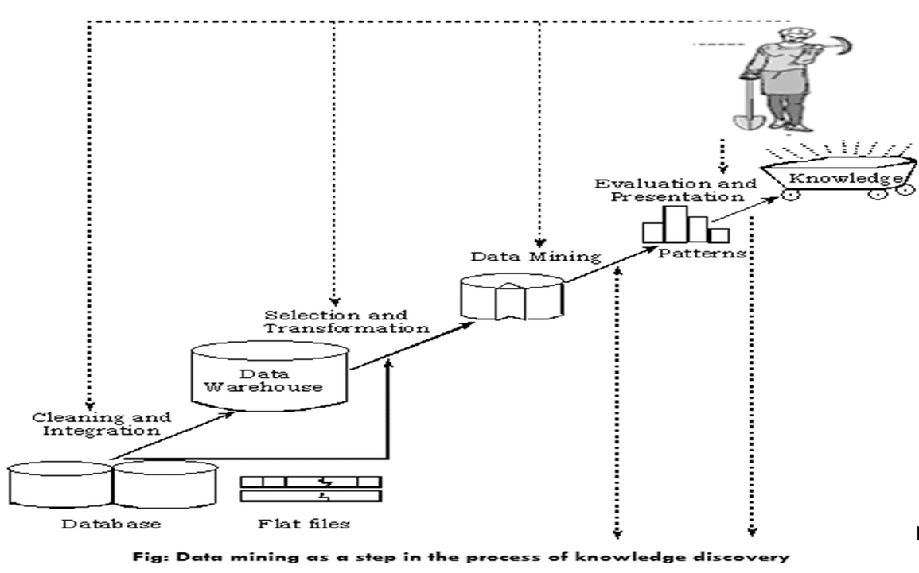
DATA MINING
•Data mining is also called Knowledge Discovery in Database (KDD).
•The knowledge discovery process includes Data cleaning, Data integration, Data selection, Data transformation, Data mining, Pattern evaluation, and Knowledge presentation.
•Here is the list of steps involved in the knowledge discovery process:
•Data Cleaning: In this step, the noise and inconsistent data is removed.
•Data Integration: In this step, multiple data sources are combined.

Slide 54
DATA MINING
•Data Selection: In this step, data relevant to the analysis task are retrieved from the database.
•Data Transformation: In this step, data is transformed or consolidated into forms appropriate for mining by performing summary or aggregation operations.
•Data Mining: In this step, intelligent methods are applied in order to extract data patterns.
•Pattern Evaluation: In this step, data patterns are evaluated.
•Knowledge Presentation: In this step, knowledge is represented.

Slide 55
WHY IS DATA MINING IMPORTANT ?
Enables informed and data-driven decision-making.
Helps in analyzing substantial amounts of data quickly.
Businesses can get reliable information through data mining.
Helps in identifying patterns and trends and detecting fraud.
It is a cost-effective and efficient option.

Slide 56

DATA WAREHOUSE
•Data warehousing is a collection of tools and techniques using which more knowledge can be driven out from a large amount of data.
•This helps with the decision-making process and improving information resources.
•Data warehouse is basically a database of unique data structures that allows relatively quick and easy performance of complex queries over a large amount of data.
• It is created from multiple heterogeneous sources.

Slide 57
NEED OF DATAWARE HOUSE
Intelligent Decision-Making: With centralized data in warehouses, decisions may be made more quickly and intelligently.
Business Intelligence: Provides strong operational insights through business intelligence.
Historical Analysis: Predictions and trend analysis are made easier by storing past data.
Data Quality: Guarantees data quality and consistency for trustworthy reporting.
Scalability: Capable of managing massive data volumes and expanding to meet changing requirements.
Effective Queries: Fast and effective data retrieval is made possible by an optimized structure.
Cost reductions: Data warehousing can result in cost savings over time by reducing data management procedures and increasing overall efficiency, even when there are setup costs initially.
Data security: Data warehouses employ security protocols to safeguard confidential information, guaranteeing that only authorized personnel are granted access to certain data.

Slide 58
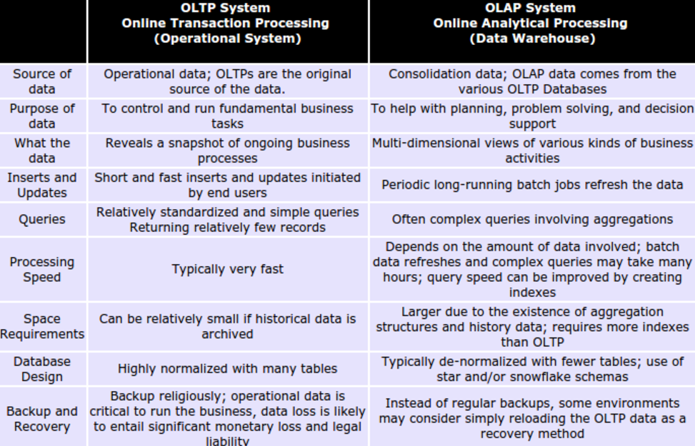

Slide 59
APPLICATION OF DATAWARE HOUSE
•Financial services
•Banking services
•Consumer goals
•Retail sectors
•Controlled manufacturing
•Information Processing
•Analytical Processing
•Data Mining
•Real Life
•Various Industries
•Statistical Analysis
•Decision Making

Slide 60
ANAMOLY AND FRAUD DETECTION
Anomaly detection involves identifying data points, patterns, or behaviors that are significantly different from the norm. These anomalies may or may not indicate malicious intent but often point to irregularities that warrant further investigation.
Examples of Anomalies in Information Systems:
Unusual login times or locations (e.g., a login from a different country).
A sudden spike in data traffic or usage.
Accessing sensitive data not typically used by a particular user.
Atypical system errors or performance lags.

Slide 61
ANAMOLY AND FRAUD DETECTION
Techniques Used for Anomaly Detection:
Statistical Methods: Setting thresholds for normal behavior (e.g., z-scores, mean/variance analysis).
Machine Learning Models:
Unsupervised Learning: Algorithms like k-means, DBSCAN, or autoencoders identify patterns without labeled data.
Supervised Learning: Classification models trained on labeled datasets of normal and anomalous behaviors.
Rule-Based Systems: Using predefined rules for detecting anomalies.
Time Series Analysis: Observing irregularities over time in system performance metrics or behavior logs.

Slide 62
ANAMOLY AND FRAUD DETECTION
Fraud detection focuses on identifying deliberate actions intended to deceive or exploit a system for personal gain. It is a subset of anomaly detection but specifically targets activities considered malicious and fraudulent.
Examples of Fraud in Information Systems:
Unauthorized transactions in a banking application.
Credit card fraud (e.g., using stolen cards or creating fake ones).
Falsified identity during online registrations.
Data breaches or theft of intellectual property.
Click fraud in online advertising.

Slide 63
ANAMOLY AND FRAUD DETECTION
Techniques Used for Fraud Detection:
Behavioral Analysis: Monitoring user behavior to detect inconsistencies (e.g., different typing speeds, mouse movements).
Machine Learning Models:
Decision trees, neural networks, or ensemble models (like Random Forest) trained on labeled fraud datasets.
Graph Analysis: Analyzing relationships and connections to identify suspicious activity, such as account takeover attempts.
Pattern Matching: Comparing activities against known fraud signatures or blacklisted behavior.
Real-Time Detection: Employing systems to flag fraudulent activities as they occur, like monitoring transactions in banking.

Slide 64



